Slide 1
5.2 Digital currency
Understand the concept of a digital currency
How digital currencies are used
Understand the process of blockchain and how it is used to track digital currency transactions
A digital currency is one that only exists electronically
Blockchain, in its basic form, is a digital ledger, that is a time-stamped series of records that cannot be altered

Slide 2
Today
Understand the concept of a digital currency and
How digital currencies are used
Understand the process of blockchain and how it is used to track digital currency transactions
A digital currency is one that only exists electronically
Blockchain, in its basic form, is a digital ledger, that is a time-stamped series of records that cannot be altered
Understand: What is blockchain
Able: Describe the features of blockchain
Answer: What is a digital currency?

Slide 3
Note:
You all have WeChat Pay / QQ / Alipay / Apple Pay
You can all pay for things using these methods.
You never really need to touch physical cash
BUT…. For Cambridge, this is NOT a digital currency
Why not?
Because all of these methods link to a bank account which is linked to a bank which is a central point for money.
Cambridge wants us to learn about blockchain and digital currency which is not centralised.

Slide 4
Digital Currency
So if WeChat Pay / QQ Pay / Alipay / Apple Pay are not digital currencies, then what is?
The values here are correct as of 7 February 2021
Bitcoin = $39,000 /252000 RMB
Ethereum $1600 / 10346 RMB
Ripple = $0.40 / 2.59 RMB
EOS = $3.00 / 19 RMB
Bitcoin Cash = $450 / 2900 RMB
Litecoin = $150 / 970 RMB
All of these digital currencies (and what Cambridge want you to know is)
All only exist electronically. There is no physical cash
They all use blockchain

Slide 5
Blockchain
Physical cash is made by a central bank / government
You can touch it
The government can decide how much money it should print and it can also control how much your money is worth.
Erm….Mr Amar, what do you mean, “how much my money is worth”. A 10 RMB note is always worth 10 RMB.
Yes this is true. 10 is always worth 10, but what you can buy / trade with 10 RMB can be changed by the government by using inflation and by what companies decide to offer their services for.
Today your 10 RMB can buy two chocolate bars. But what if all the coco plants (the stuff that makes chocolate) burns down and now we don’t have enough coco plants.
Well, chocolate prices would rise because the demand is higher than the supply.
Or for a government example, the best example is Zimbabwe

Slide 6
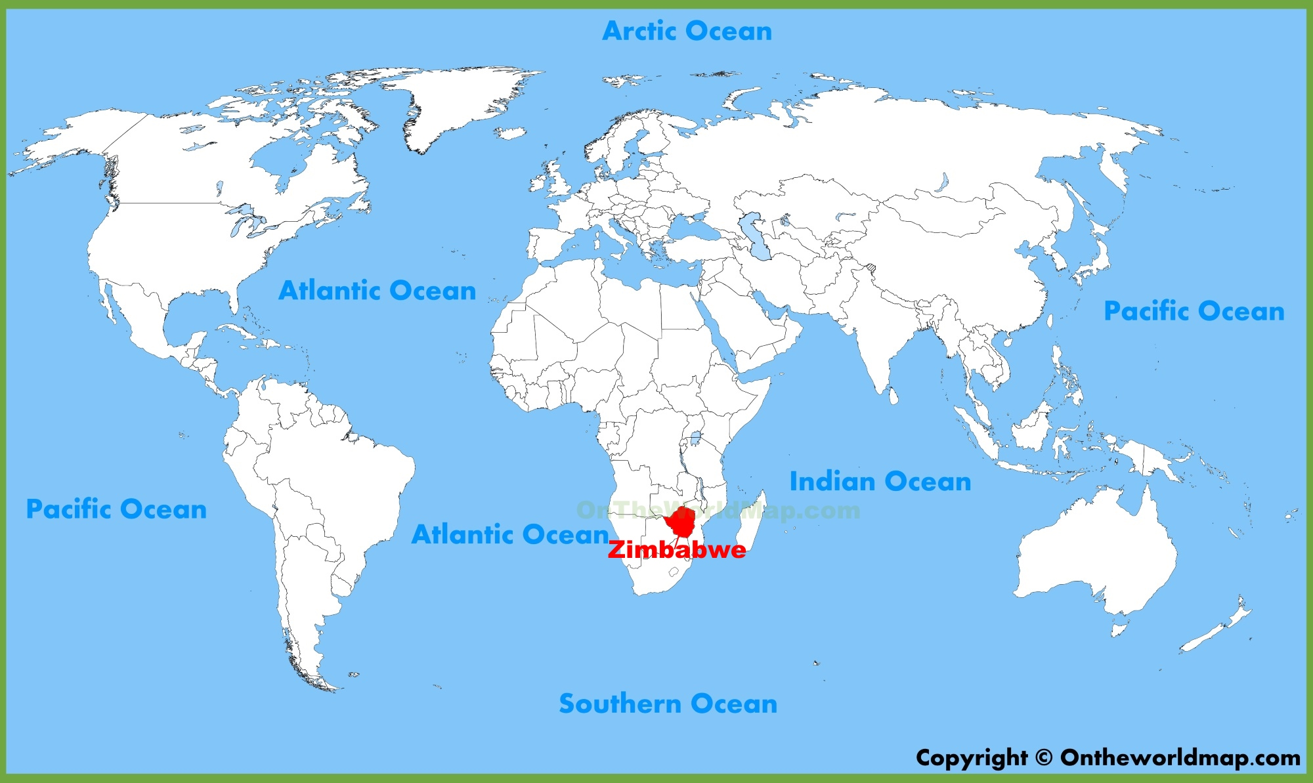
History
Zimbabwe, in Africa has lots of gold, diamonds and other natural resources. So, in the 19th century, a group of British white people, decided to take over.
How? The British people had guns and the native people didn’t. So for a long time Zimbabwe was controlled by white people.
This upset the native Black people and they decided to take back power.

Slide 7
History
One thing that happened after power was taken back was that if you was a White person who had a farm, well now that farm was taken over by a Black person.
No problem right? White people took the land, they used the land to grow food and now Black people will take back that land.
Only problem was that Black people didn’t have interest in farming. Because of this, the amount of food the country produced dropped between 50-90%
This meant less food.
This meant the food they did have would have to cost more.
This meant the government had to print more and more money, with bigger denominations

Slide 8
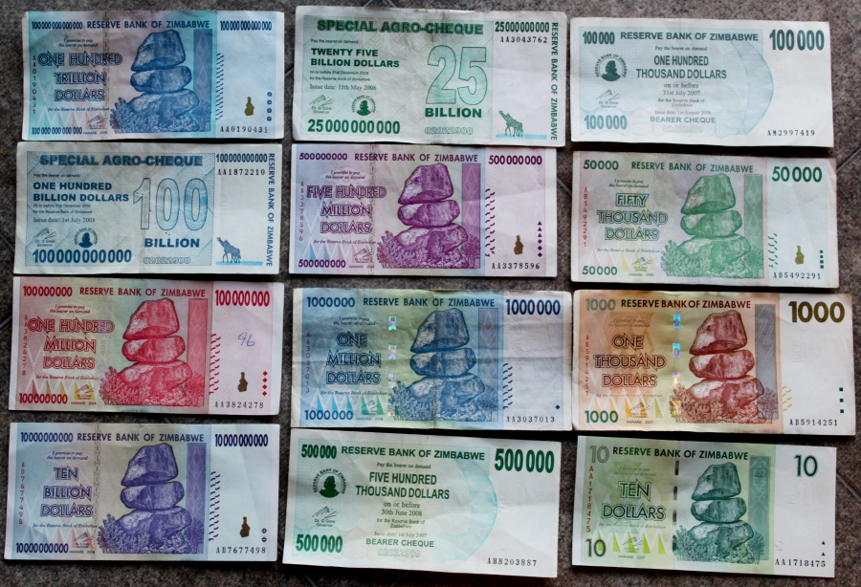
Money
Up to a hundred trillion dollars.
That’s
100000000000000
(14 zeros)
Worth around $70 / 450 RMB
And every time the government printed more money and bigger denominations , it meant that the money you had became worthless.
Imagine if you had 10 billion dollars and now the government prints a 100 trillion then your 10 billion dollars is worth nothing

Slide 9
Blockchain
Blockchain was designed to avoid the problems of centralisation.
To avoid having a central government or big companies having control over how much money is worth.
Blockchain does this by using ledgers
Actually even real banks use ledgers
Ledger = A big list.

Slide 10
Ledger
If I have 100 RMB, and I give you 20 RMB
How much money do I have?
80. And you have 20 RMB
If we was using WeChat for this transfer then my bank (Bank of China) would record that I gave you 20 RMB.
Your bank would record this as you getting 20 RMB
The banks would record it on their internal ledger
A ledger is a big list that records transactions
Your bank’s ledger belongs only to your bank, it’s a centralised ledger

Slide 11
Distributed Ledger
Your bank uses a centralised ledger, block chain uses a distributed ledger.
This means EVERYONE who uses blockchain has a list that shows what transactions have been done.
Every time a new transaction is made, everyone’s ledger are updated.
If you try to cheat, then everyone can check everyone else’s ledger to see if it matches and can see that you tried to cheat.

Slide 12
Ledger vs Blockchain
So is a distributed ledger the same as blockchain?
No.
Blockchain just uses a distributed ledger
It also uses:
Hash values
Proof-of-work
Hash values = A really big, unique number, that is created by some mathematical operation on data
Proof-of-work = The time it takes to calculate a hash value

Slide 13
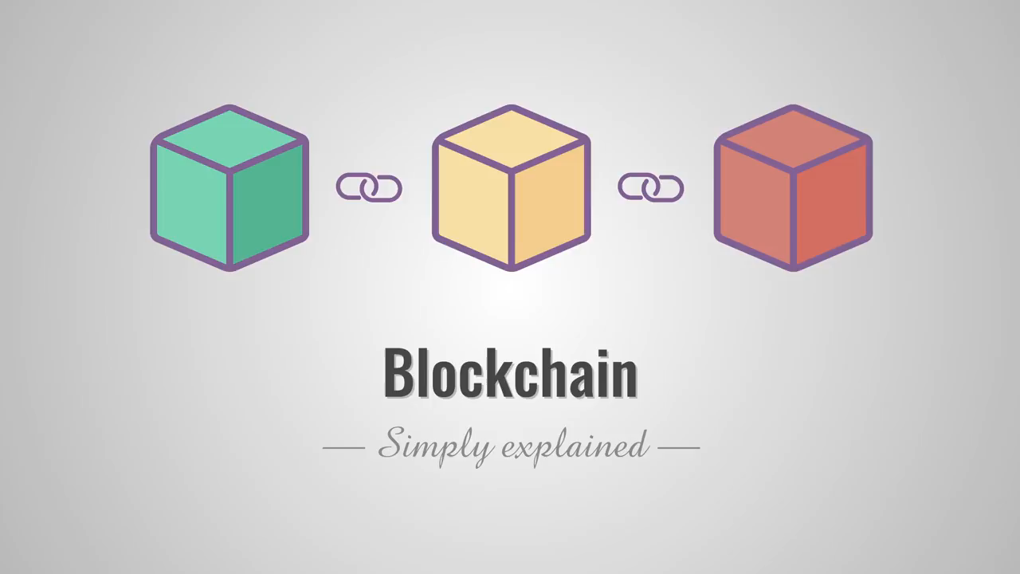
Video
1: When was Bitcoin founded?
2. What 3 things make up a block?
3. What 3 things make up bitcoin data?
4. What is a hash?
5. What is proof-of-work?
6. What is the other name for the first block?
7. What type of network does blockchain use?

Slide 14
